Slide 1
GAZTERM 2018
Bartosz Kajak, bkajak@autosoln.com David Blanco, dblanco@autosoln.com

Slide 2
AGENDA
Profile
Featured products
Polish-American SCADA Security

Slide 3
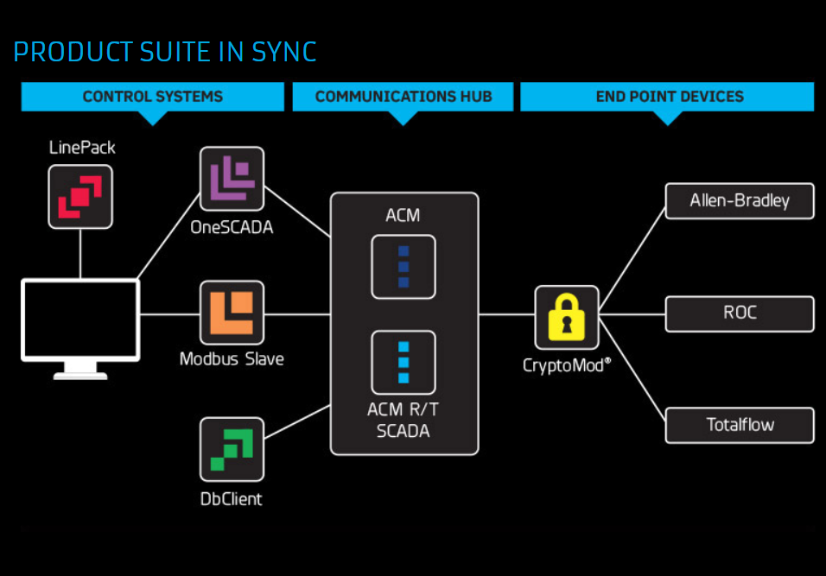
AUTOSOL Overview
Servicing our clients’ SCADA needs since 1987
Oil, natural-gas, water, and building SCADA
Offering software, hardware, and services

Slide 4
Energy Portfolio
430,000 RTUs and PLCs use AUTOSOL for comms
Customers’ pipelines span from Mexico to Canada.
Notes:
AUTOSOL’s expertise and excellent products were recognized by the largest pipeline operators in the U.S., Kinder Morgan operating 70,000 miles of natural gas pipelines, as well as Canada, TransCanada, operating 57,100 miles of natural gas pipelines.
Our portfolio includes work with Cheniere Energy, operator of the largest LNG export terminal in the U.S. and Canadian company Enbridge with stake in 205,424 miles of pipelines.

Slide 5
Scale of Operation
Kinder Morgan pipelines map
TransCanada pipelines map

Slide 6
Natural Gas Market
U.S. became a net gas exporter in 2017
Three LNG export terminals in the U.S.
Five terminals under construction
U.S. to be third largest LNG exporter by 2020.
Natural gas consumption to increase 40% by 2050
Notes:
Revolution of shale gas production propelled by development of horizontal drilling technology and construction of LNG export terminal allowed the U.S. to became a net gas exporter in 2017.
The are currently three operational LNG export terminals in the U.S. with another five currently under construction.
U.S. Energy Information Administration predicts that the U.S. will become the third largest LNG exporter in the world by 2020.
U.S. domestic consumption of Natural Gas increases as well, Natural Gas is expected to remain most-consumed fuel in the industrial sector. Industrial consumption is expected to increase by 40% by 2050.
Increased exports and domestic consumption means infrastructure expansions and more natural gas flowing through U.S.’s pipelines.
AUTOSOL’s products allows companies to increase productivity and expand resources quickly. AUTOSOL supports fast scalability, extends the use life of the system and provides integration of modern and legacy field devices.

Slide 8
Advanced OPC Polling-Engine
Real-time polling
Flow Measurement
Supports 18 SCADA telemetries
Supports 30+ Protocols
Relational Database

Slide 9
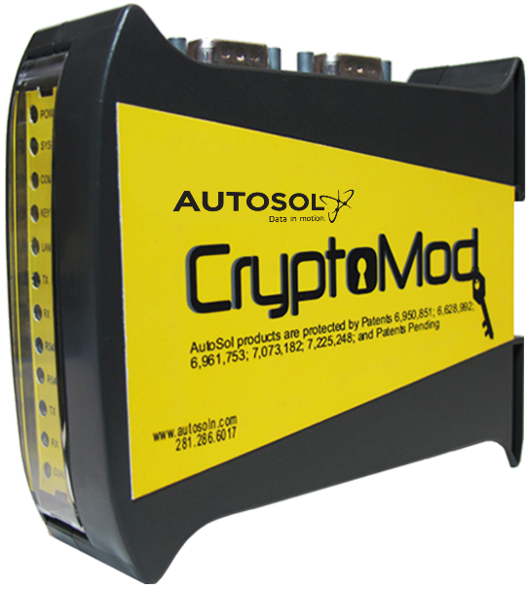
Endpoint security device
Technical Security Controls
Legacy Compatibility
Field Level Logs
Integrated Control System
Mass Management (ACM)
Cloud Compatibility
Remote Updating

Slide 11
Polish & American SCADA Security
Shared experiences for SCADA:
Equipment
Vulnerabilities
Security Challenges
Adversaries

Slide 12
Cybersecurity Trends
Increasing trend of attack frequency & intensity
FY 2016: 110% increase in attacks
ICS-CERT
FY 2015: 189 vulnerabilities
FY 2016: 700 vulnerabilities
Cybersecurity, Energy Security, and Emergency Response formed 2017

Slide 13
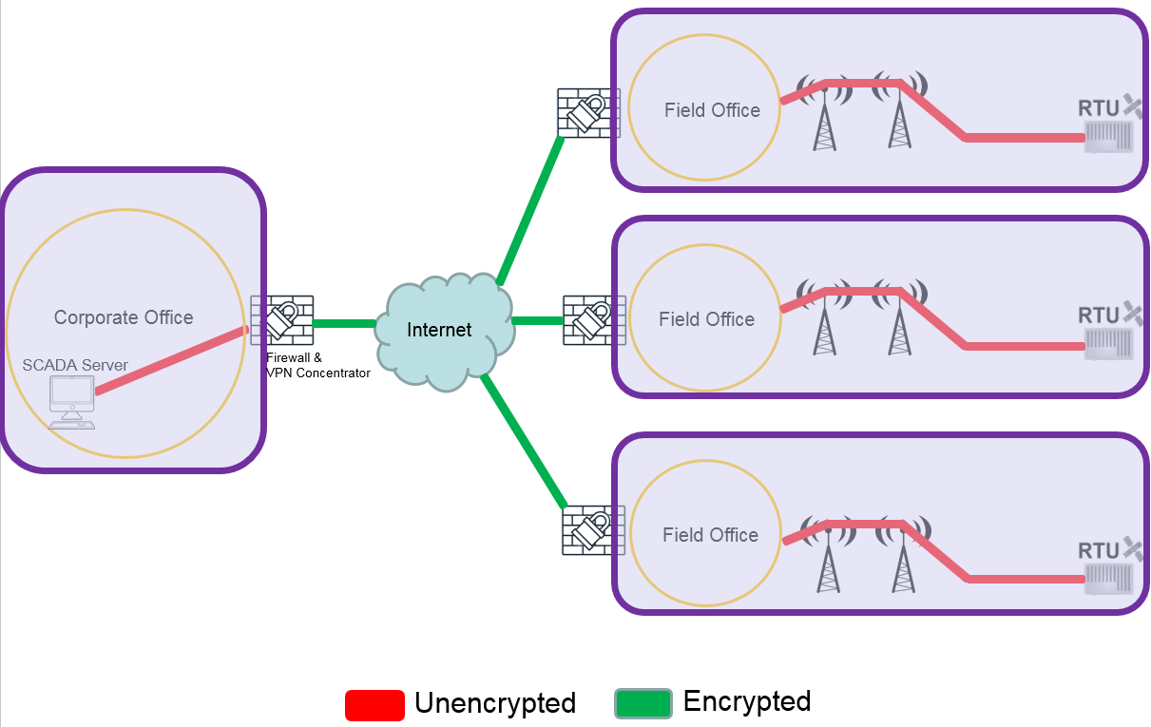

Slide 14
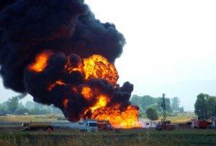
Baku-Tbilisi-Ceyhan (BTC) Pipeline
Valve Station 30
Over-pressurize pipeline
Suppressed alarms
Deleted security footage
Deleted logs
30,000 barrels spilled
$1.5 billion + cost
Seven owners

Slide 15
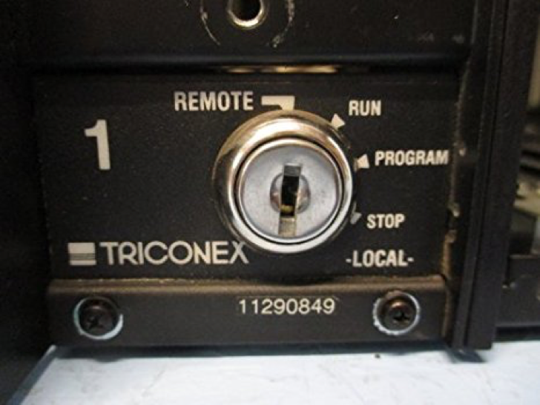
TRITON
Infected engineer's workstation
Communicated in proprietary protocol
Monitored TriStation
Detected firmware and key-switch status
Injected RAT onto controller
Full access
Reset controller to good status
Coded to delete itself if failed

Slide 16
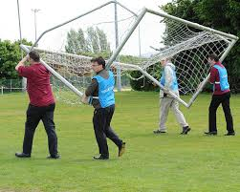
Talking Security
Hackers have the
Technical knowledge
Time
Resources
Motivation
Triconex, version 10.3, “Achilles Controller Level 1 cybersecurity certificate”
Shifting landscape of cybersecurity
Safety issues
Moving goal posts, conversation changes

Slide 17
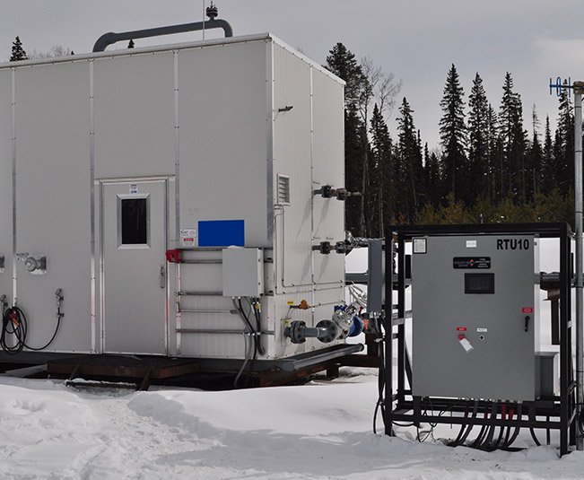
Equipment Issues
Legacy Equipment Issues
Static defenses against elements
Features become vulnerabilities
Not security devices
Vendors not cyber-experts
Stuxnet pressure transmitter
TRITON @ S4

Slide 18
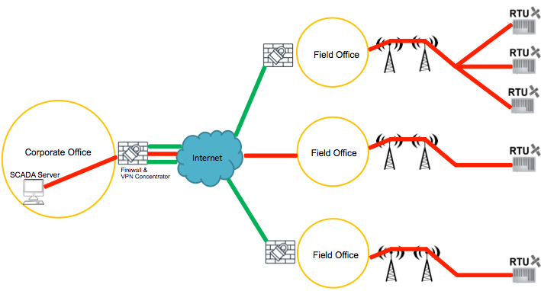
SCADA Solutions for SCADA Problems
Prioritize the relationship between the controller and the field equipment.

Slide 20
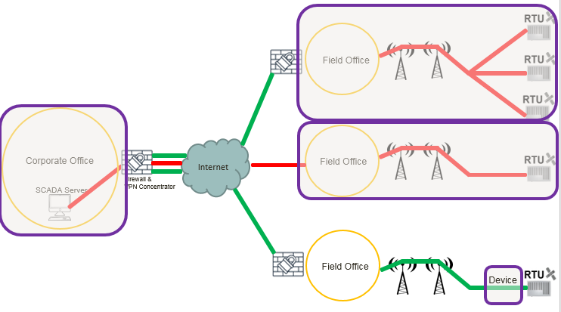
Network Edge Security

Slide 21
Leader in communication technology and cybersecurity
Eager for Polish and European partnerships

Slide 22
Questions?
Join us at booth ####

