Slide 1
LNG Diversification
Greg Vesey, Managing Director and Chief Executive Officer
May 7, 2018

Slide 2
Forward looking statement
The information in this presentation is not an offer or recommendation to purchase or subscribe for securities in any one or more entities in the LNGL Group or to retain or sell any securities currently being held. This presentation does not take into account, nor is it intended to take into account, the potential and/or current individual investment objectives and/or the financial situation of investors.
This presentation was prepared with due care and attention and the information contained herein is, to the best of LNGL Group’s knowledge, as of the date of the presentation.
This presentation contains forward-looking statements that are subject to risk factors associated with the gas and energy industry. The expectations reflected in these statements are currently considered reasonably based, but they may be affected by a range of variables that could cause actual results or trends to differ materially, including but not limited to: price and currency fluctuations, the ability to obtain reliable gas supply, gas reserve estimates, the ability to locate markets for LNG, fluctuations in gas and LNG prices, project site latent conditions, approvals and cost estimates, development progress, operating results, legislative, fiscal and regulatory developments, economic and financial markets conditions, including availability of financing.
No representation or warranty (express or implied) is or will be made by any person (including LNGL Group and its officers, directors, employees, advisers and agents) in relation to the accuracy or completeness of all or part of this document, or any constituent or associated presentation, information or material (collectively, the Information), or the accuracy, likelihood of achievement or reasonableness of any projections, prospects or returns contained in, or implied by, the Information or any part of it. The Information includes information derived from third party sources that has not necessarily been independently verified.
Subject to any continuing obligations under applicable law or any relevant stock exchange listing rules, LNGL Group disclaims any obligation or undertaking to disseminate any updates or revisions to any forward looking statements in this presentation to reflect any change in expectations in relation to any forward looking statements or any change in events, conditions or circumstances on which any such statements were based.
To the maximum extent permitted by law, each entity in the LNGL Group, along with each entity’s respective officers, employees and advisers, excludes all liability (including in negligence) for any loss or damage which may be suffered by any person as a consequence of any information in this presentation or any error or omission there from.
All references to dollars, cents or $ in this document is a reference to US Dollars, unless otherwise stated.
Notes:
Standard Safe Harbor language

Slide 3
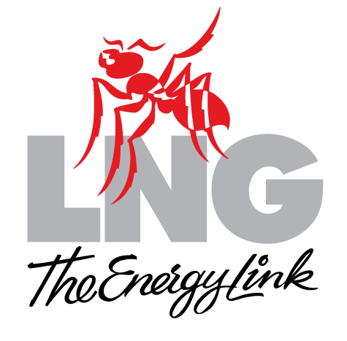
Corporate structure
BEAR
HEAD
LNG
MAGNOLIA
LNG
LNGL is an Australian public company (ASX: LNG U.S OTC sponsored ADR: LNGLY)
Developer of mid-scale LNG export terminals
Projects are indirect wholly owned subsidiaries
Developing 20 mtpa of capacity using OSMR® process technology
Notes:
Reasonably simple corporate structure
Development focused
Allows for structure optimization once production begins

Slide 4
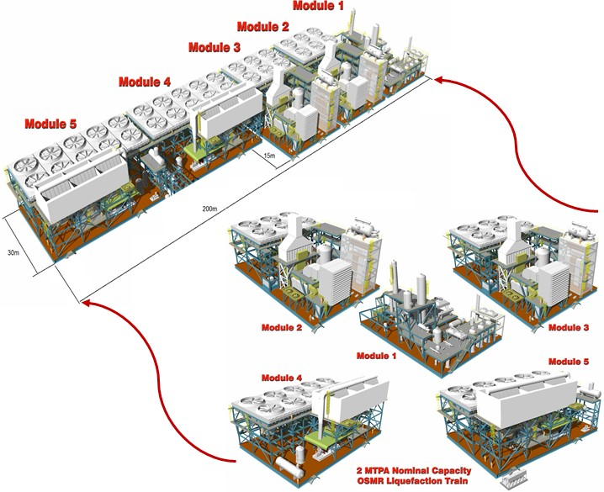
Competitive strengths
Full cycle cost and energy efficient OSMR® technology and implementation strategy
Approach to site selection
Mature regulatory, engineering, contracting, and financing status
Focus on minimizing ecological impacts
Stakeholder relations
Experienced management team and highly capable technical and operational personnel
LNG Limited is favorably differentiated from the competition

Slide 5
U.S. lower 48 natural gas reserves
Source: U.S. Energy Information Administration – 2016 data published in Feb 2018
Technically recoverable resource equals 84 years of current production

Slide 6
Gas supply basin access
Marcellus/Utica
Permian
Barnett
Haynesville
Eagle Ford
Magnolia LNG
Magnolia LNG is well-positioned for feed gas supply optionality

Slide 7
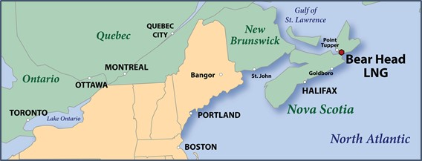
KMLP feed gas supply access for Magnolia LNG
Pine Prairie Storage
Texas Eastern
1.4 Bcfd of Capacity to Magnolia LNG
Florida Gas
Texas Gas
Columbia Gulf
Transco
ANR
Proposed New Compressor Station on KMLP
Magnolia LNG
KMLP’s interconnects access Gulf Coast and Northeast gas supply basins

Slide 8
Henry Hub pricing
Henry Hub is and will remain a stable price band

Slide 9
A LNG buyer’s future LNG portfolio
40% – 20 year contract
There is continued demand for long term contracts with LNG spot prices expected to increase
LNG demand may continue to increase as additional uses are found for the fuel such as LNG bunkering
40% – three to five year contracts
20% – spot pricing
Offtakers without long-term agreements leave themselves open to price volatility and unknown market dynamics
Future LNG project portfolios allow for buyer’s distinct and diverse needs

Slide 10
Yearly net LNG imports / exports in 2035
Russia
(36 mtpa)
(11 mtpa)
Europe
121 mtpa
28 mtpa
North America
(158 mtpa)
3 mtpa
Middle East
(64 mtpa)
(81 mtpa)
Asia
315 mtpa
136 mtpa
Africa
(50 mtpa)
(27 mtpa)
Central and South America
14 mtpa
(4 mtpa)
Projected 2035 Range of Trade
(Exports) – 430 mtpa
Imports – 450 mtpa
Australia
(122 mtpa)
(44 mtpa)
Actual 2016 LNG Trade
Imports (Exports)
Sources: LNGL interpretation of data from BP, Shell, Wood Mackenzie, and Poten & Partners
Note: Differences in supply vs. demand results from variations in estimates
U.S. LNG can easily supply all of Europe’s future LNG import needs

Slide 11
US LNG contractual advantages
Level negotiating field
Transparent market driven pricing
Legal certainty
Independent court system
Cancellation rights
Flexible deliveries / no destination clause
Make-up rights
The choice is obvious

Slide 12
Magnolia LNG competitive advantages
LSTK EPC contract
All FERC permits
All environmental permits
DOE Non-FTA approval
Pipeline Precedent Agreement
Equity commitment
Operations and maintenance contract
Fully de-risked contracting certainty

Slide 13
Forward looking statement / Non-GAAP financial measures
The following presentation, together with all information and data contained in verbal and other written statements or presentations made by or on behalf of Liquefied National Gas Limited (“LNGL”) (ASX: LNG) (OTC ADR: LNGLY), whether related to LNGL or any of its assets, affiliates or subsidiaries, including, without limitation, Magnolia LNG, LLC (“Magnolia LNG”), LNG Technology Pty Ltd (“LNG Technology”), Gladstone LNG Pty Ltd (“Gladstone LNG”), Bear Head LNG Corporation (“Bear head LNG”) (LNGL, Magnolia LNG, LNG Technology, Gladstone LNG, Bear Head LNG and any other assets, affiliates or subsidiaries, whether named or unnamed, are referred to herein as the” LNGL Group”), contains forward-looking statements concerning LNGL Group’s strategy, operations, financial performance, plans, projections and expectations, all of which are subject to uncertain conditions and circumstances in the various countries, sectors and markets in which LNGL Group operates or is planning to operate.
The Private Securities Litigation Reform Act of 1995 (“PSLRA”) provides safe harbor protections for forward-looking statements in order to encourage companies to provide prospective information about their business. LNGL Group intends to rely on the benefits of the safe harbor provisions of the PSLRA and includes this cautionary statement for purposes of disclosure and disclaimer. Forward-looking statements are based on assumptions involving judgments and predictions concerning the future and are not statements of historical facts. Without limitation, the words "anticipate," “assumptions,” "believe," “could,” “enable,” "estimate," “estimated,” "expect," "expected," "forecast," “formulated,” "intends," "may," “on track,” “opportunity,” "pending," "plan," "potential," “progress,” "project," “ready,” “replicate,” "should," “targeting,” “tracking,” and similar expressions identify forward-looking statements. Forward-looking statements are not guarantees of outcome, results, performance or any projections, and involve significant risks, uncertainties and assumptions, the results of which often differ materially from those expressed in the forward-looking statements. Factors influencing these results are beyond LNGL Group’s ability to control or predict.
LNGL Group’s ability to fulfill its objectives, goals, strategies, synergies and revenue, income or cash flow are subject to significant national, international, regional and local economic, competitive and regulatory conditions and developments, as well as technological competitive developments; energy, credit and capital markets conditions; inflation and interest rates; political and economic instability of oil producing and consuming nations; business and regulatory or legal challenges, decisions and outcomes; timing and success of business development efforts and opportunities; as well as weather conditions and other uncertainties. No person or company should put undue reliance on forward-looking statements. Nothing in this presentation or any forward-looking statement should be used as a substitute for any party’s own due diligence investigation, nor relied upon by any party in deciding to invest in LNGL Group or any of its projects, or to retain or sell any securities in any one or more of the entities in the LNGL Group. No person acting directly or indirectly for LNGL Group is authorized to make any representation or warranty, express or implied, concerning the accuracy or completeness of the information in this presentation and any forward-looking statements.
LNGL Group undertakes no obligation to update any forward-looking statements, and does no assume or accept any responsibility or liability for any inaccuracies in this presentation or forward-looking statements. Neither this presentation nor any forward-looking statement made by or on behalf of LNGL Group shall constitute an offer to sell or the solicitation of an offer to sell any securities in any jurisdiction in which such offer, solicitation or sale would be unlawful prior to registration or qualification under application securities laws of such jurisdiction. No offer of securities in LNGL Group shall be made except by means of a prospectus satisfying the standards of the Securities Act of 1933, as amended or other applicable law.
LNGL Group may use or express non-generally accepted accounting principles (“non-GAAP”) financial measures in this presentation and forward-looking statements. LNGL Group undertakes no obligation to reconcile non-GAAP financial measure to comparable GAAP measures. Non-GAAP measures should not be considered an alternative to or substitute for GAAP financial measures.
NOTHING IN THIS PRESENTATION OR FORWARD-LOOKING STATEMENTS SHALL SERVE AS A SUBSTITUTE FOR ANY REGISTRATION STATEMENT, PROXY STATEMENT OR PROSPECTUS, IF ANY, FILED BY LNGL GROUP WITH APPLICABLE SECURITIES EXCHANGES. INVESTORS AND INTERESTED PARTIES ARE URGED TO CAREFULLY REVIEW ANY REGISTRATION STATEMENTS, PROXY STATEMENTS AND PROSPECTUS, IF ANY, FILED WITH APPLICABLE SECURITIES EXCHANGES.

Slide 14
Contacts
Liquefied Natural Gas Limited
45 Ventnor Avenue, West Perth WA 6005, Australia
Telephone: (08) 9366 3700; Facsimile: (08) 9429 8800
1001 McKinney, Suite 600 Houston, Texas 77002, USA
Telephone: +1 713 815 6900; Facsimile: +1 713 815 6905
Email: LNG@LNGLimited.com.au Web site: www.LNGLimited.com.au
ASX: LNG; OTC ADR: LNGLY
Americas/Europe Mr. Micah Hirschfield Sr. Manager, Communications and Investor Relations +1 713 815 6920 mhirschfield@lnglimited.com | Australia/Asia Mr. Andrew Gould Group Development Manager and Joint Company Secretary +61 (0)8 9366 3700 AGould@lnglimited.com.au

