Slide 1


Secure OT
Jak zadbać o cyberbezpieczeństwo automatyki przemysłowej w branży energetycznej

Slide 2

Why OT needs to be secure

Slide 3

IT and OT are converging
Cost
Performance
Productivity
Agility
Enabling business to reap the benefits of cyber-physical systems
Big data and
data analytics
Cloud computing
IoT
Robotics and automation
3D printing
Augmented reality
ERP
PLC
Internet Protocol
CRM
HMIs
SCADA
IT
Data Accumulation & Storage
BMS
OT
Human to Machine
SQL
Direct monitoring and control
Physical Equipment
Business Applications
ICS

Slide 4

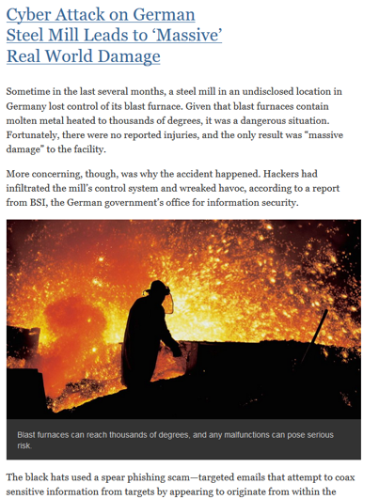
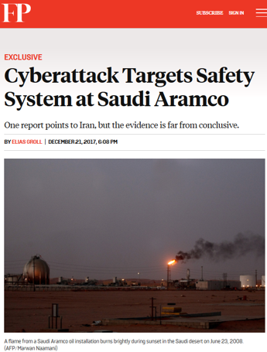
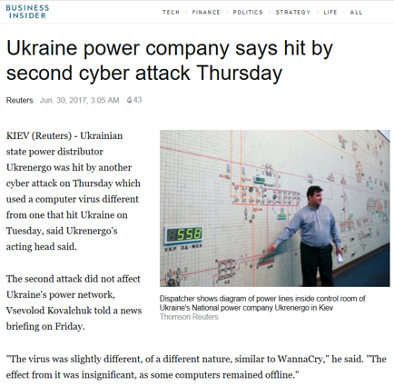
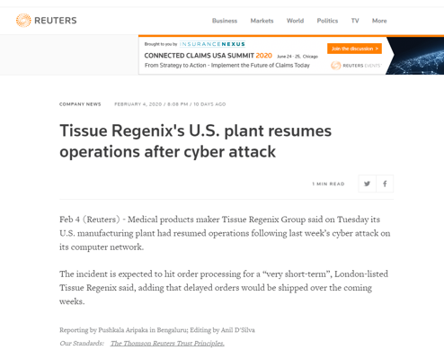
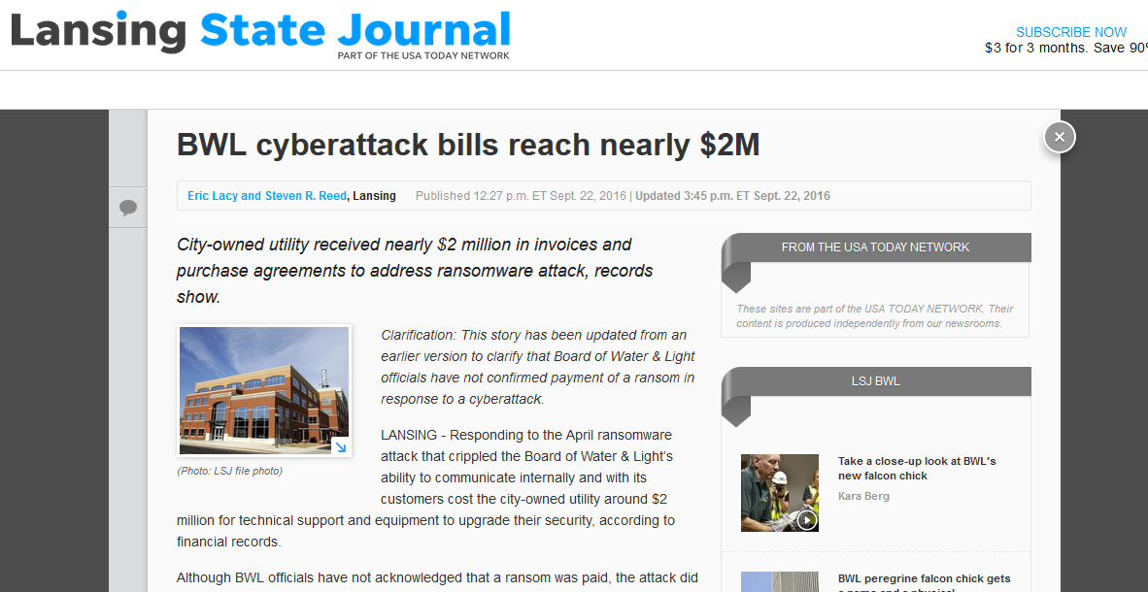
Lapses in IT/OT security lead to real consequences

Slide 5

We’re listening:
Assumptions increase risk

Slide 6




Assumptions that leave organizations vulnerable
My business needs to move quickly. I can consider OT security later or ‘as required’.
Safety, productivity, operational efficiency and profitability are all compromised if you do not build cybersecurity in from the start and you’ll be on the back against cyberthreats.
OT devices have been working well for years, it’s not a priority to patch them and could lead to business disruption if I do.
Basic security hygiene across new and old OT devices, like patching and firmware updates, is a must to reduce risk.
Security operations do not need to be centralized.
If you do not address security by engaging IT, OT and relevant stakeholders across your business, it’s very likely your cybersecurity posture will have gaps, leaving your business vulnerable.
My OT network does not need to be segmented from my IT network.
Segmentation is critical to minimizing the spread of threats across your IT network, for efficient monitoring for unusual behaviour, and controlling and preventing unnecessary access.
Notes:
My business needs to move quickly. I can consider OT security later or ‘as required’.
Safety, productivity, operational efficiency and profitability are all compromised if you do not build cybersecurity in from the start and you’ll be on the back against cyberthreats.
An OT device is safe if not connected to the internet and the communication protocols used by OT devices help to protect it.
Any device connected to a network could expose your organization to cyberthreats.
Security operations do not need to be centralized.
If you do not address security by engaging IT, OT and relevant stakeholders across your business, it’s very likely your cybersecurity posture will have gaps, leaving your business vulnerable.
Attacks come from outside OT environments, rather than inside.
There are a number of entry points for a cyberattack and not all are introduced conducted by malicious intent.
OT devices have been working well for years, it’s not a priority to patch them and could lead to business disruption if I do.
Basic security hygiene across new and old OT devices, like patching and firmware updates, is a must to
reduce risk.
My OT network does not need to be segmented from my IT network.
Segmentation is critical to minimizing the spread of threats across your IT network, for efficient monitoring for unusual behaviour, and controlling and preventing unnecessary access.
Cyberattacks are generally targeted and my low-profile OT environment will not be targeted.
Threat actors are known to move laterally throughout your organization. Where there is a vulnerability to be exploited, they’ll take advantage, even if their initial target was not your OT environment

Slide 7

We’re listening:
Key challenges our clients face

Slide 8


Key challenges we hear from clients and where we can help
Strategic
Visibility across the OT and IT environment to help drive intelligent decisions
Ensure alignment between IT and OT stakeholders
on OT security posture
and approach
Calculate and justify ROI for security investments
Gain the intelligence necessary to make security decisions that align with business objectives.
Confidence that you will be cyber-resilient in the event of a cyberattack
Operational
Clear inventory of assets and supporting infrastructure within their scope of operations
A properly segmented security architecture
that provides higher operational uptime and reduces spread of threats from IT to OT environment
Continuous threat intelligence and detection of anomalies, vulnerabilities, known and zero-day threats across the
IT and OT environment t
The ability to respond to and recover from threats and attacks, quickly and effectively
Expertise and professional support to guide and support my team along
our journey

Slide 9



IT and security leaders are asking fundamental questions:
Where and how do I start?
How do I engage
OT leaders?
What are the top
3-5 most important things
that I need to be
doing well?
How can I ensure
that what I’m doing
is working?
How can I manage my
OT security program?
How can I assure
stakeholders that we are
focused in the right areas?
How do I take a
business risk
approach to
securing my OT environment?
How can I get visibility into all my assets and how they
are connected?
Notes:
How do I engage my OT leaders?
How can we bridge the gaps between IT and OT approach?
What’s the best approach for segmenting my environment?
What’s the best way understand what assets are out there, how they are connected, and how can I manage this over time?
How can I identify potential threats?
What actions should I take when potential threats are identified?
How can I provide remote access to third parties to support systems in a secure manner?
How can I classify assets based on business impact and risk?
How can I identify vulnerabilities in my environment ….and how do I mitigate?
What is the minimal Cybersecurity defence to stop basic malware?
Are IT and OT aligned in Cybersecurity strategy?

Slide 10
Businesses still lack the necessary cybersecurity maturity
The difference between current and target state is one driven by aspiration, not necessarily where they need to be.
Target
2.94
2.90
3.57
Insights from the
NTT Ltd. 2020 Global Threat Intelligence Report
Figure 1: Maturity level gap across global businesses
Notes:
Furthermore, the NTT Ltd. 2020 Global Threat Intelligence Report demonstrates that although organizations have begun making small advances in securing their environments, they’re still behind where they need to be.
The difference between current and target state is one driven by aspiration, not necessarily where they need to be. Many business drivers, including cost, compliance, and resources, are all factors which may result in achieving less than the desired goals. In order to close the gap, each of these industries must ensure a constant focus is placed on maturity of processes, tools, and executive support.

Slide 11


















Our Intelligent Cybersecurity solutions
Security Consulting Services
Secure digital transformation
Secure CX
Secure workplace
Secure collaboration
Secure connected workplace
Secure applications
Enhance employee experience
with Intelligent Workplace
Support Services
Technical Services
Secure data center and hybrid cloud
Secure OT
Secure networking
Secure data center
Secure public and private cloud
Secure connectivity and access
Secure SD-WAN
Managed Security Services
/
Supported by all the right partners
Notes:
Our solutions combine our intelligence-driven services, and industry leading technology, to help you secure your key areas for digital transformation.

Slide 12






Secure OT
Realize the business benefits of IT and OT convergence while effectively managing risk.
Transformation | Data | Applications
Cybersecurity posture
that spans your IT and
OT environments.
Visibility of your OT assets and communication flows across your OT environment.
Visibility of and early detection of threats before they spread from your IT to OT environments.
Segmentation and
control across your OT network and devices.
Managed security services to support
your IT and
OT operations.

Slide 13
We can help you with our secure by design approach
  5 key pillars
1
2
3
4
5
  We’ll create a security strategy aligned to what
  the business’
  risk-tolerance is, and
  in line with what the
  business wants and
  needs to achieve
  We’ll help you to
  build-in, rather than
  bolt-on security to
  your digital programs,
  be it your network,
  data center, cloud,
  employee or customer experience initiatives
  We design an integrated security architecture that enables businesses
  to be agile in the
  face of a changing threat landscape and
  technology ecosystem
  We’ll work with you
  to ensure security
  is a key tenant of
  a business’ overall business strategy
  Our experts will
  help you build an
  intelligence-driven cybersecurity posture
Notes:
We’ve adopted a secure by design approach because we believe that cybersecurity no longer be an afterthought.
‘Secure by design’ means being cybersecurity conscious at all levels of the business, building-in cybersecurity at the beginning, rather than bolting it on or retrofitting security just prior to launch.
Our five-step approach helps us to ensure security is a key tenet of your business strategies and digital programs moving forward.

Slide 14

Our intelligence-driven
Cybersecurity Services

Slide 15

Security Consulting Services
We help you to develop security strategies and roadmaps aligned to their business goals and risk-profile
as well as design and build a
next-generation enterprise
security architecture.

Slide 16





Security Consulting Services
Security business strategy services
Assurance services
Architecture & design services
Incident management & response services
Governance, risk and compliance services
Services that cover
the entire lifecycle
of security to help organizations visualize and execute successful security programs.
We examine and test our client’s controls, policies and processes to identify cybersecurity vulnerabilities, and provide them an action plan to improve their security posture.
We assess our client’s security posture, identify gaps, and recommend improvements to ensure client’s security architecture is ‘secure by design’ and aligned to their business needs.
Moving organizations from crisis to continuity in the face of an incident, our experts help with plan development
and deployment.
We examine our client’s security risk and compliance posture, quantify the risk and develop and prioritize
a remediation plan for compliance gaps and business risks.
Includes our Cybersecurity Advisory Services for OT

Slide 17






Our Cybersecurity Advisory service for OT is a business-outcome driven consulting engagement with a flexible, modular framework that spans the entire lifecycle of security from developing a strategy and plan aligned to your business needs, optimizing existing security controls, to designing your next-generation OT security architecture, policies and control framework.
We engage your key stakeholders and subject matter experts through a series
of workshops and interviews to analyze
the maturity of capabilities of your organizations aligned to industry recommended best practices and expertise.
Together, we determine the gaps
between your security posture today
versus where you should be and how
your organization bridges the gap to
meet future requirements.
Cybersecurity Advisory for
Operational Technology
We then benchmark the results against
other organizations in your industry
and region to develop a highly tailored recommended roadmap focused on improving the efficacy of your OT cybersecurity program supporting operational resiliency.
An action-oriented roadmap to
support budget and resource allocation
or simply aligned to an existing strategy
for confirmation and reassurance.
Notes:
Covers the entire lifecycle of security from developing a strategy and roadmap aligned to your business needs, optimizing existing environments, to designing your next-generation enterprise security architecture.
We help to ensure your organization is security conscious as you transform through innovative digital programmes.

Slide 18

Technical
and Support Services
We can help you to design, implement and optimize your security posture across your infrastructure.

Slide 19





Technical and Support Services
Cybersecurity analysis services
Technology & controls selection
Design
services
Deployment services
Uptime and proactive
support services
We examine your controls, policies and processes to identify cybersecurity vulnerabilities, and
give you an action plan to improve your security posture
From the myriad possibilities in the market, we help you to identify and select
the right tools and controls for your organization’s
particular needs
We develop detailed designs for the tools and controls for your organization's particular cybersecurity needs
We deploy and optimize the tools
and controls for your organization's particular cybersecurity needs
We monitor and maintain the multi-vendor security tools and controls that are implemented in your environment
Notes:
Our Cybersecurity technical and support services help you to design, implement, support, and optimize your security infrastructure, improving operations and reducing costs.
Our experts are able to help you do this through:
Cybersecurity analysis services - We examine your controls, policies and processes to identify cybersecurity vulnerabilities, and give you an action plan to improve your security posture
Selection of tools and controls - From the myriad possibilities in the market, we help you to identify and select the right tools and controls for your organization’s particular needs
Design Services - We develop detailed designs for the tools and controls for your organization's particular cybersecurity needs
Deployment services - We deploy the tools and controls for your organization's particular cybersecurity needs
Uptime Maintenance Services - We monitor and maintain the security tools and controls that are implemented in your environment

Slide 20







Why choose NTT Ltd.?
We’re focused on your business outcomes as we help you to create an
intelligence-driven security posture across your digital business.
We can help
you from wherever
you are on your
cybersecurity journey.
We provide the
security skills and expertise you need.
We can support your
global footprint and regional presence.
We share our extensive cross-technology expertise to ensure your digital solutions
are secure by design.
We provide the industry, regional and global insights through our research and experience with more than 4000 clients.
We partner with all of
the leading security
technology providers.
We invest in
security capabilities
you need now and in
the future.
We offer advanced threat intelligence capabilities
to help you make informed risk-management decisions.
Notes:
Why choose NTT for cybersecurity?
We offer the full lifecycle of security services from consulting, to technical and support and managed security services.
We have over 2,000 cybersecurity employees around the world dedicated to securing our clients, who are certiﬁed across multiple vendors, technologies, and industry standards.
We operate in 57 countries around the world, offer in-country support services and have local language capabilities.
We have 7 R&D centers around the world and have invested 100M USD in cybersecurity R&D.
We develop our own IP to address market gaps and client security needs.
We have global partnership agreements with leading technology providers mean that you get off-the-shelf access to the cybersecurity technology you need rather than having to scout, evaluate, and integrate them all yourself.
We continually assess, select, and pre-integrate partner technology into our managed security services platform.
Through our Global Threat Intelligence Center, Cybersecurity Advisory Benchmarking and experience in serving more than 4000 security clients around the world, across multiple industries.
Our experts can embed security across your network, data center, applications, clouds to ensure you are secure as you digitally transform.
We have 5 Security Operation Centers around the world, analyzing billions of logs each day to help you find the needle in the haystack.
Our visibility of vast amounts of cross/net flow data allows us to see attacks as they are being stood up to advise clients on proactive defense.
We have insight via global, proprietary honeypots to capture advanced malware and attacks, including those for IoT and web applications.
We combine our vast data sources, human expertise and proprietary threat intelligence capabilities for advanced threat detection analysis that is 99% accurate.

Slide 21




Our credentials
2,000
cybersecurity employees
around the world
We operate in
57 countries around the world
More than 4,000 security clients around the world, across multiple industries.
Full lifecycle of cybersecurity services
Invested
more than USD 100M
in cybersecurity R&D and innovation
7
R&D Centers
5
Security
Operation Centers
Global agreements with the
leading security technology providers.
Our advanced threat detection analysis is 99% accurate
Secure
by design approach
More than 9.5TB of security data analyzed every day to help you find the needle in the haystack.

Slide 22



Our Experts work across your OT and IT environments as they converge, enable a better understanding of the vulnerabilities in the client’s infrastructure using our threat intelligence, allowing us to remediate their risk exposure while they focus on their business.
Team
27 – OT Security Experts – Global
7 – OT Security Experts – Europe
2 – OT Security Engineers – Poland
Global Approach
Local Capabilities
People & Technology
Technology
Cyber Vision
Nozomi
Claroty
CyberX
CheckPoint / Cisco / FortiNet / PaloAlto

Slide 23

Our Clients
Realize the business benefits of IT
and OT convergence while effectively managing risk.
Reference projects
  43 Clients References
  21 in Utilities
  8 in Oil & Gas
Confidentiality
  NTT has exacuted many cybersecurity projects within the OT Network. However, because it’s cybersecurity in nature, we take client privacy and confidentiality very seriously.
  Due to this,, we’re not able to disclose the actual client name nad contact.
  We can, it you would like to talk to any of these clients, we’re more than happy to facilitate 1 on 1 confidential conversation with these clients.

Slide 24
Together we do
great things

